Slide 1
Educating for the future: New locality models for English schools
Susan Cousin
Jonathan Crossley-Holland

Slide 2
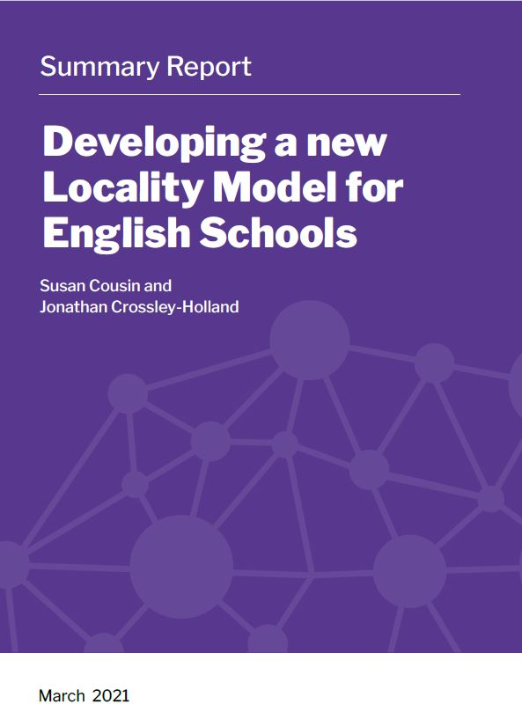
Sponsored by AEC Trust and BELMAS

Slide 3
Contents
Research aim and approach
Features of high-performing systems
Comparison to English system
Locality working
Pilots to further develop locality working
Discussion

Slide 4
RESEARCH AIM
To develop locality partnership models for an education system to deliver high quality education for all.
CONCEPTUAL APPROACH
A functional analysis of seven governance functions:
Teacher recruitment and retention
Support for vulnerable pupils
Curriculum
School improvement
Accountability and quality assurance
Admissions and places planning
Building a system for the future
RESEARCH STRATEGY
Phase 1 Literature review Design principles from 4 leading international systems
Phase 2 Interviews (17)
Phase 3 Stakeholder consultation on recommendations arising
Notes:
Interview 17 leaders from different parts the system, to obtain their response to the best practice principles and
the challenges to the current system identified in the literature review
Reports produced: one for each phase and one summary report

Slide 5
Choice of leading system
Ontario (Canada), Estonia, Finland and Singapore
A successful system is one with both high achievement and high equity (OECD)
Range of models of governance: all three of Sahlberg’s (2007) global models: ‘Anglo-Saxon’ (markets, choice and competition); ‘Pacific’ (authoritarian, conformist, high expectations); and ‘Nordic’ (high status, high trust, devolved responsibilities within national frameworks).
Singapore top of PISA; Finland, Estonia and Canada are the only non-Asian nations to consistently reach the top rankings in PISA.
Notes:
Programme for International Student Assessment: a worldwide study by the Organisation for Economic Co-operation and Development (OECD) in member (all since 2003) and non-member nations, (total 71 – 9/10ths of the world economy) intended to evaluate educational systems by measuring 15-year old school pupils’ performance in mathematics, science and reading. 2000, the focus reading 2015, science. Also tests in an innovative domain such as collaborative problem solving in 2015 and global competence in 2018. Some countries also test financial literacy. 2018 results pub 3 Dec 19. Estonia: The rate of secondary attainment is among the highest in the EU and OECD areas, and proportion of adults holding a tertiary qualification is above the OECD average. TIMMS age 13 more content; PISA application. Trends in International Maths and Science Study

Slide 6
Other Metrics
a ‘rising star’ (Estonia) and a ‘falling’ one (Finland)
Finland continues to score at the top of metrics of international performance from
‘educating for the future’ (WEFFI, 2018, 2019)
‘happiness’ (Helliwell et al., 2020)
“It is the higher levels of social and institutional trust that are especially important in raising happiness and reducing inequality.” (Helliwell, et al. 2020: 5)
Notes:
The report was produced by the United Nations Sustainable Development Solutions Network and edited by three economists: Dr. Sachs, the network’s director and a professor at Columbia University; John F. Helliwell, a senior fellow at the Canadian Institute for Advanced Research and professor emeritus at the University of British Columbia; and Richard Layard, a director of the Well-Being Program at the London School of Economics’ Center for Economic Performance. It is based on Gallup surveys conducted from 2015 to 2017, in which thousands of respondents were asked to imagine a ladder with steps numbered 0 to 10 and to say which step they felt they stood on, a ranking known as the Cantril Scale. Finland 1st, Canada 11th, UK 13th, Singapore 31st, Estonia 51^{st, Afganistan 153rd.}

Slide 7
Findings
1. Literature Review

Slide 8
Leadership from the Middle (LftM)
“a deliberate strategy that increases the capacity and internal coherence of the middle as it becomes a more effective partner upward to the state and downward to its schools and communities, in pursuit of greater system performance” (Fullan, 2015: 24).
“we don’t want the inadequacies of tightly controlled centralization being replaced with the equal flaws of school and community autonomy”
top-down leadership doesn’t last due to lack of sustainable buy-in from professionals; bottom-up change (e.g. school autonomy) doesn’t result in overall system improvement: some schools improve, others don’t and the gap between high and low performers grows wider
complex systems need interlocking coherence rather than merely linear alignment of strategies and reform elements
Notes:
Previous study Bubb et al, JCH, me and Peter E Hargreaves and Braun 2012
A single reform strategy cited by all 4

Slide 9
Alignment
Ministers, regions, localities, individual schools and parents share a vision of the purpose of education and are aligned in collective endeavour
Subsidiarity
Decisions are devolved to the level as close to delivery as consistent with effectiveness
Capacity Building
Positive Ethos built on moral purpose
Whole system focus
Design principle
Definition
A positive ethos is deliberately cultivated by Ministers, the media, professionals and public. Power imbalances are minimized
Coordination of resources and solutions for efficiency, equality of access, cost-effectiveness, economies of scale. Alignment of incentives
Professional development is a priority, focused on accurate self-evaluation, honest feedback and sharing of evidence-informed practice
Notes:
Arising from lit review. Asked respondents Phase 2

Slide 10
Findings
Literature Review
Interviews

Slide 11
Interviews
Matt Hood, Principal National Oak Academy,
Daniel Mujis, Deputy Director, Research and Evaluation, Ofsted
Nicola McCleod, Principal Skills Lead Greater Manchester Combined Authority
Steve Munby CBE, Visiting Professor, University College London. Former CEO EDT and NCSL
Dame Alison Peacock, Chief Executive of The Chartered College of Teaching. Former Executive Head
Luke Raikes, Director of Research Fabian Society. Former IPPR lead on the Northern Economy
Samira Sadeghi, Head of Academies Governance at Academies Enterprise Trust (AET)
Sahreen Siddiqui, Headteacher, part-time Ofsted inspector
Professor Samantha Twiselton, Director, Sheffield Hallam Institute of Education, Vice President, Chartered College of Teaching
:
Sir Tim Brighouse, Former Chief Education Officer Birmingham; Schools Commissioner for London, 2002-7
Sir David Carter, Director, Ambition Institute. Former National Schools Commissioner, MAT CEO
Jenny Coles, Director Children’s Services, Hertfordshire, President Association of Directors of Children’s, Services (ADCS)
Sir Jon Coles, Chief Executive United Learning; Former Director General of Schools DfE and Director of London Challenge
Maria Dawes, CEO Schools Alliance for Excellence (SAfE), AEP, Surrey Schools
Kirin Gill, CEO, The Difference
Richard Gill, MAT CEO and Chair of the Teaching Schools Council
Christine Gilbert, Visiting Professor, UCL Institute of Education. Formerly HMCI
Notes:
We asked; how important are those principles to the English education system and how far does our system measure up against them?

Slide 12
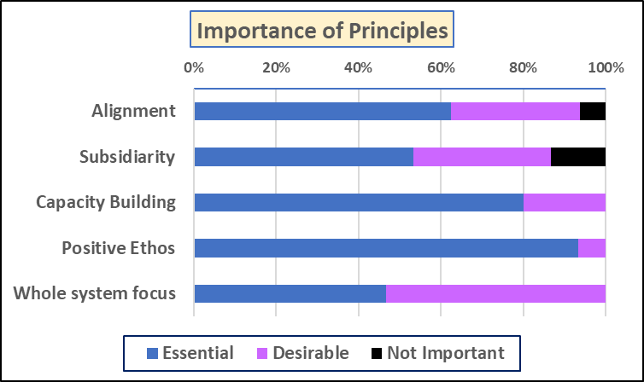
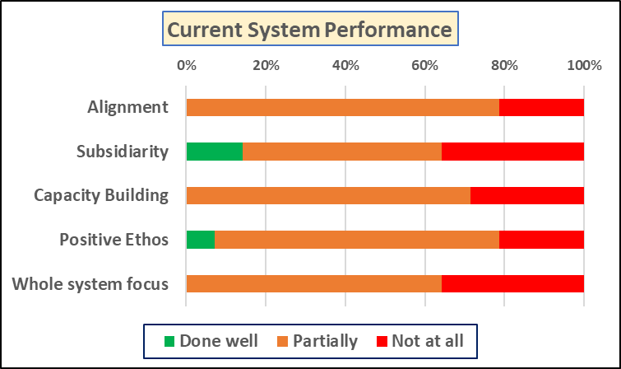
Respondent views (n = 17)
Notes:
We also asked of the 7 functions: at which level of the system should decision-making lie?

Slide 13
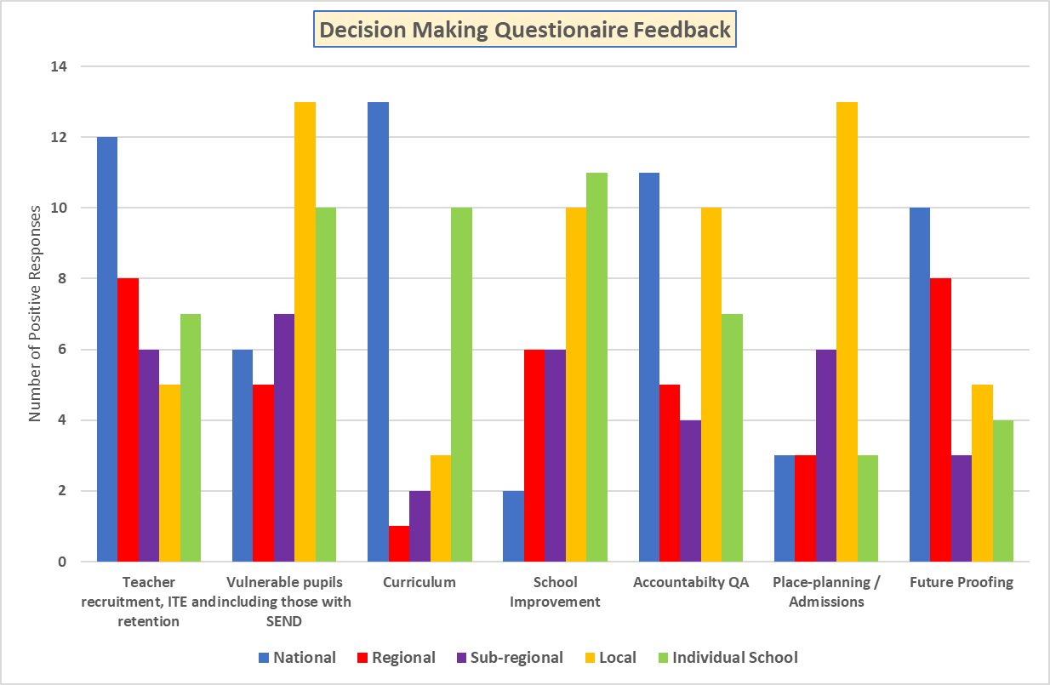
Notes:
Functional decentralisation: National: Curric, Teacher supply and future-proofing Local/LA: Admissions, Vulnerable pupils/SEND, places planning Regional/local: SI and a/c – within national framework. No outright consensus – reflection of both political leanings and the complicated nature of the tensions, shared by all systems

Slide 14
Governance functions are interdependent
Governance function | Issues | Impact
Recruitment and retention of teachers | Accountability, workload, ethos/trust/hierarchies | ‘Career suicide’ to lead a challenging school Shortages disproportionately affect low SES schools
Admissions | Multiple admissions authorities | Exclusions (inc 40%), off-rolling, local lotteries (SEND), disempowerment of parents/carers
Curriculum | Narrowness, the numbers failing, excessive reliance on/cost of exams | (re)growing social attainment gap The ‘forgotten third’ Starts pre-school and widens each phase Within-school segregation
School improvement | Focus on ‘proving’ rather than ‘improving’ | Unregulated ‘market’ of providers Unequal access to support mechanisms
Accountability | Barriers to collaboration | Incentivises perverse behaviours
Places-planning | Segregation, M/C capture | Lack of local accountability
Building for the Future | Widening poverty and attainment gaps. Well-being, future skills | Assistive-learning, universal digital access Global citizens, empowered pupils
Notes:
Summary of findings from the study: governance functions are interdependent. A lack of alignment and focus on the whole system results in issues with each function – summarised here - and the impact of those issues adds up to a cumulative negative effect on vulnerable pupils where the disadvantage increases as they move through the system. Limited power of LA to enforce FAPs. Pandemic highlighted and reinforced the inequalities.

Slide 15
Locality-based governance
Definition: a holistic approach to education across a local area (p.34)
rooted in localities (local knowledge, release initiative, increase engagement)
outward-looking (wider expertise and resource, avoiding insularity or entrenching disadvantage)
Benefits
provides essential “glue” or coordination
mobilises collective sense of responsibility to reduce competition which drives local hierarchies and increases the effects of disadvantage
focus on contextual factors which can provide barriers to achievement or offer solutions. ‘One size fits all’ (consistency) Vs flexibility (local responsiveness)
increase cost-efficiencies, prevents ‘reinvention of the wheel’
identity matters
Covid 19 highlighted the importance of infra-structure and local partnerships
Notes:
We found many examples of place-based, locality based approaches. An appetite for more locality based governance but no consensus on what constitutes a locality. Different for diff functions. Diff solutions in different areas? Primary vs secondary phases? OAs, AEPs, combined authorities – need evaluation.

Slide 16
Locality models
A: centrally-led coordination, dissemination or roll-out of evidence-based practice
152 Local Authorities
8 RSCs
Teaching school networks and hubs
EEF Regional Directors and research schools networks
STEM/English/mathematics regional hubs
B: locally-led place-based partnerships
32 Area Education Partnerships
Challenge Partners
Local initiatives supported by charities
C: both?
12 Opportunity Areas
Combined authorities

Slide 17
Findings
Literature Review
Interviews
Focus Groups

Slide 18
Focus Groups
ADCS Education Achievement Policy Group, Chaired by Gail Tolley DCS Brent
Nick Brook, Deputy General Secretary National Association of Head Teachers
Gina Cicerone, CO-CEO Fair Education Alliance
Alastair Falk, Coordinator Foundation for Education Research, founder of Birmingham School Area Based Partnership
Ian Keating: Policy Lead Education and Social Care, Local Government Association
Emma Knights: CEO, National Governance Association
Andrew Lancashire, Service Director Education and Inclusion, Wakefield City Council
Kerry-Jane Packman, Executive Director, Parentkind
Mark Patton, Assistant Director: Education and Skills, Newcastle City
Sacha Schofield, Headteacher, Bents Green Special School, Sheffield
Phillip Searson, Headteacher Longfield Schools, NLE and School Improvement Lead, Embark MAT
Notes:
14 recommendations drawn from the lit review and interviews were shared with 33 people in 3 focus groups. From the consultation and feedback, three main proposals were agreed as potentially fruitful to be further developed. Funding has been agreed for pilot studies to start in January.

Slide 19
Stakeholder views
14 recommendations drawn from the lit review and interviews were shared with 33 people in 3 focus groups
3 main proposals were agreed as potentially fruitful to be further developed
funding has been agreed for pilot studies to start Spring 2022

Slide 20
Next steps
Pilots

Slide 21
Educating for the future: 9 pilots of locality models
Invitations in January 2022, to develop locality models to:
1. Support vulnerable learners
2. Work in Combined Authorities as the basis for school improvement
Rebalance the accountability system drawing on peer review
Pilots will
make the most of the current system
draw on international best practice
be supported by the AEC Trust, the main funders of the research
run for 2 years

Slide 22
Pilot 1: Disadvantaged and Vulnerable Learners
Aims
to create oversight and transparency across a local area to track the progress of this cohort of young people and develop an effective action plan
to test the right set of metrics that would allow this, including: operation of the Fair Access Protocol; numbers coming in and out of Pupil Referral Units; identification and tracking of CME; EHE; EOTAS - all children who don’t have access to a full time curriculum because they’ve been off-rolled or are on a PT curriculum
to explore reasonable adjustments to curriculum and teaching & learning to allow these young people to succeed without exclusion
to strengthen partnerships between all agencies
to explore opportunities through collaboration to enrich the offer
to share successful practice in supporting these young people

Slide 23
Pilot 2: School Improvement in Combined Authorities
Aims
to test the conditions needed to establish a successful cross-LA school improvement arrangement which involves all schools and Trusts
to analyse how this could support all schools to improve and be based on the principles of collaboration and the open sharing of best practice
to test the advantages and disadvantages of organising on this basis

Slide 24
Pilot 3: Locality-based accountability
‘There was a strong view that the accountability system needs to be recalibrated, away from a focus on proving towards improving.’
‘Respondents stressed the need to recalibrate towards a medium stakes accountability system, in terms of the use made of inspection and exam results, and for the removal of the punitive consequences that currently impact negatively on morale and public perception.’
‘A continuously monitored, supportive system would prevent headteachers and teachers leaving the profession by reducing what many believe has become a ‘toxic’ culture. Importantly, it would be no less rigorous and provide regular, robust feedback for timely improvement.’

Slide 25
Aims of the pilot
to develop an approach to accountability level that:
gives important support to teachers and schools in their work and planning
establishes a rigorous system of professional accountability, operating within and across schools, assured by the local partnership board
encourages teachers to feel part of a professional learning community that acts as a source of professional aspiration and development, not only within their own school but across the locality too
provides clear information for parents
The pilots will:
develop a vision of what greater professional accountability looks like in action
develop or strengthen processes (self-evaluation, peer review, appraisal and school report cards)
agree a range of indicators that give a fuller picture of the school and its achievements than those in the current public accountability framework
use the on-going learning from the pilots to consider how parts of the public accountability system, for example Ofsted, could evolve to provide stronger support, even validation, for a system of professional accountability

Slide 26
AEC Trust Support for the Pilots
ISOS will provide support throughout the 2 year life of the pilots.
ISOS will use an action learning approach to bring the pilots for each strand together to learn from each other & capture learning in 6 monthly reports.
They will provide some extra capacity to the pilots.
The Trust will fund a lead for the locality accountability pilots-very pleased to say Christine Gilbert has agreed to take that role.
The Trust will fund and maintain a website to promote dialogue between the pilots and engage externally with the work of the pilots.
External evaluations after 12 months & at the end of the advantages and disadvantages of locality working

Slide 27
References
Phase_1_The_Role_of_the_Middle_Tier_Lessons_from_four_high-performing_education_systems_(1).pdf (belmas.org.uk)
Phase_2_Analysis_of_Interviews.pdf (belmas.org.uk)
Phase_3_Report_Final_(1).pdf (belmas.org.uk)
Locality Model Summary Report.pdf
Fullan, M. (2015) ‘Leadership from the Middle: A system strategy’ Education Canada. December 2015 pp 22-26
Hargreaves, A. and Shirley, D. (2020) ‘Leading from the middle: its nature, origins and importance’in Journal of Professional Capital and Community, Vol 5 No 1 pp 92-114, Emerald Publishing Limited
Helliwell, J. F., Layard, R., Sachs, J. and De Neve, J. (eds.) 2020, World Happiness Report 2020, New York: Sustainable Development Solutions Network
Worldwide Educating for the Future Index (2019) https://educatingforthefuture.economist.com/

Slide 28
Thank you
Expressions of interest to:
jcrossleyholland1@mail.com
Questions, Comments?

